Slide 1

NETWORKING FOR BIG DATA AND LABORaTORY
Francesco Lauro 1706784
Michele Luca Puzzo 1783133

Slide 2
General Information
Some available statistics by Capinfos
File name | _00000_20190410070000.pcap
File type | Wireshark\...-pcapng
File encapsulation | Ethernet
File timestamp precision | microsecond(6)
Packet size limit | file hdr: (not set)
Packet size limit | inferred: 34 bytes - 96 bytes (range)
Number of packets | 1000k
File size | 98MB
Data size | 1099MB
Capture Duration | 3,637099 seconds
First packet time | 2019-04-10 - 07:00:00,056001
Last packet time | 2019-04-10 - 07:00:03,693100
Data byte rate | 302MBps
Data bit rate | 2419Mbps
Average packet size | 1099,84 bytes
Average packet rate | 274kpackets/s

Slide 3
Time Evaluation between Sequential and Parallel reading
 | Time
Sequential reading | 2672.002 seconds
Parallel reading splitting the pcap trace in 5 smaller pcap trace made by 200,000 pkts | 1047.805 seconds
Parallel reading splitting the pcap trace in 10 smaller pcap trace made by 100,000 pkts | 530.910 seconds
Parallel reading splitting the pcap trace in 20 smaller pcap trace made by 50,000 pkts | 474.921 seconds
Parallel reading splitting the pcap trace in 100 smaller pcap trace made by 10,000 pkts | 499.204 seconds
Best performance of parallel reading is 5.63 faster than sequential one!

Slide 4
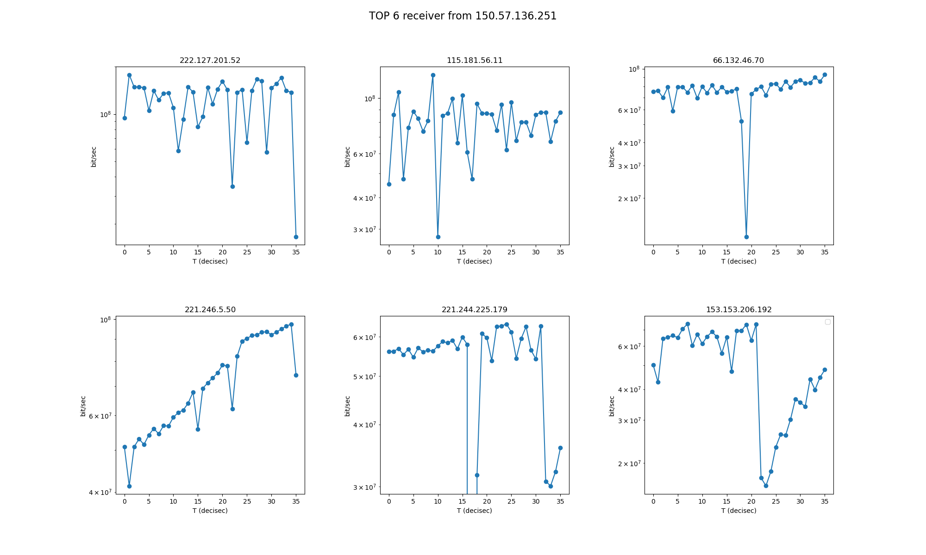
Note: In the fifth plot the seventeenth value is equal to zero bit/sec, for this reason it cannot appear in the log scale plot.

Slide 5
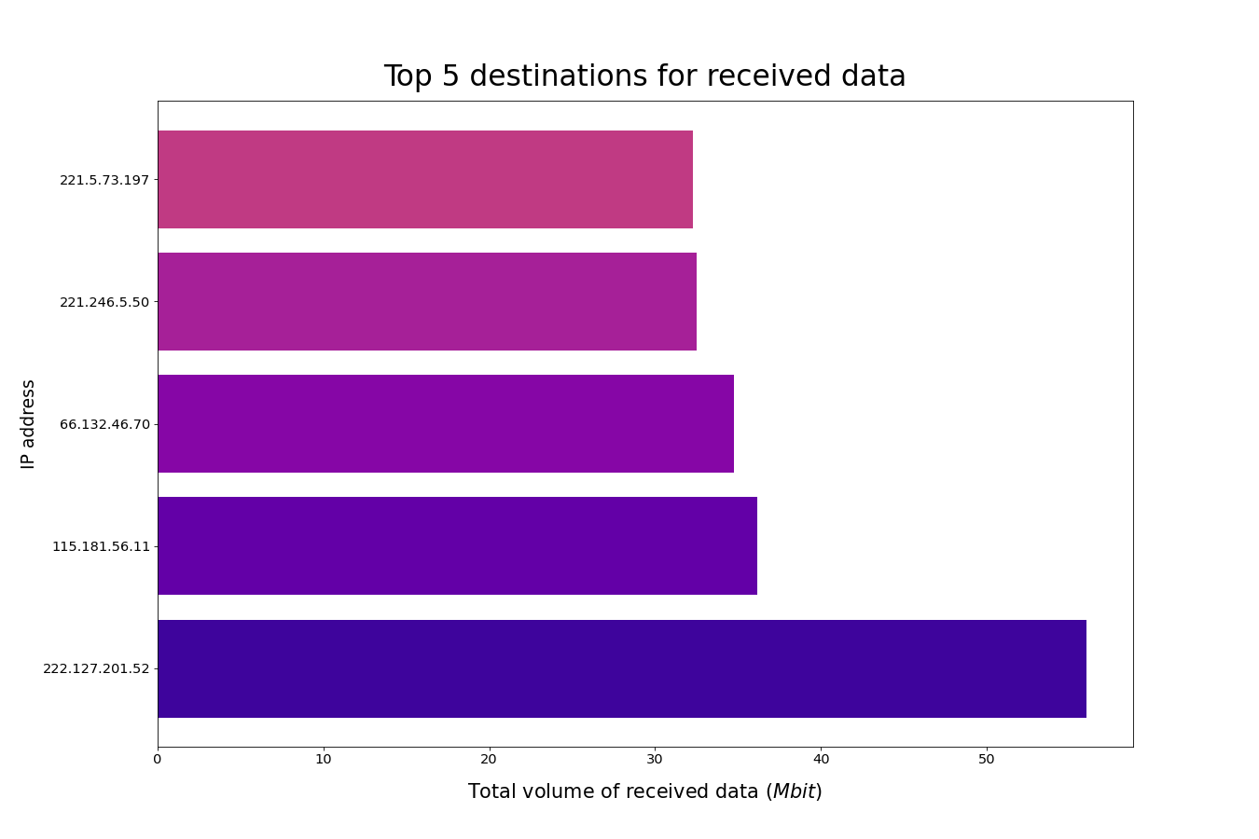
Code:
dataFrame.groupby(["IP_DST"])[['length']].agg('sum’).
sort_values(by=['length'], ascending=False).head(5)

Slide 6
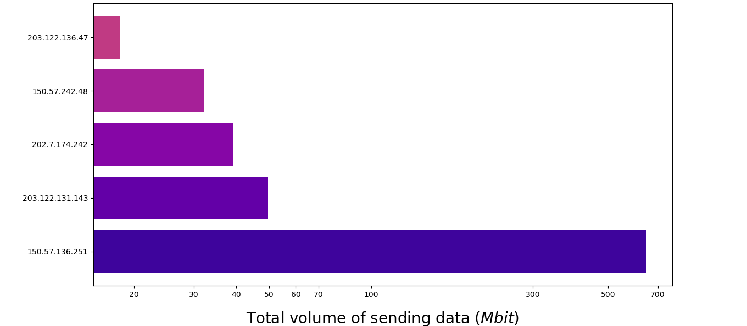
TOP 5 SENDER IP address
Code: dataFrame.groupby(["IP_SRC"])[['length']].agg('sum').sort_values(by=['length'], ascending=False).head(5)

Slide 7
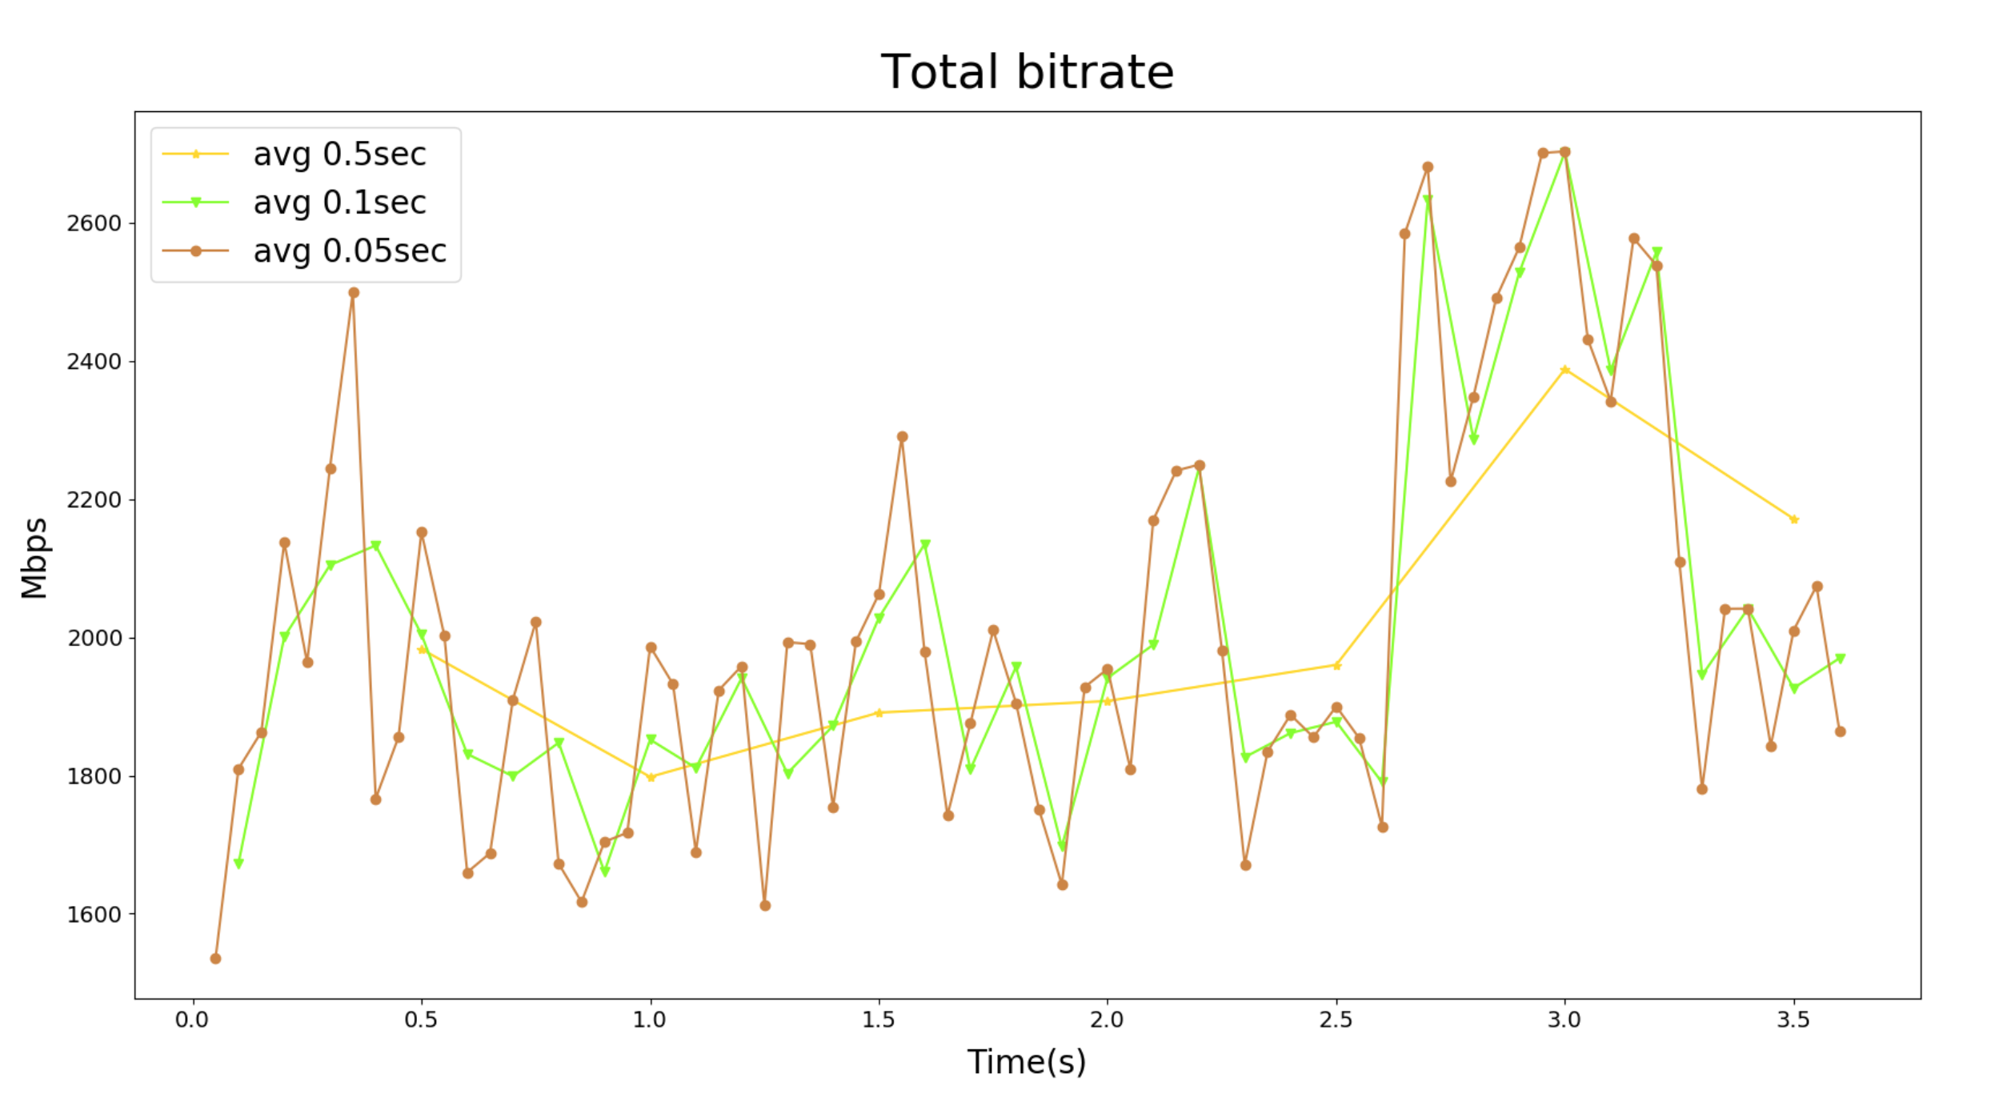

Slide 8
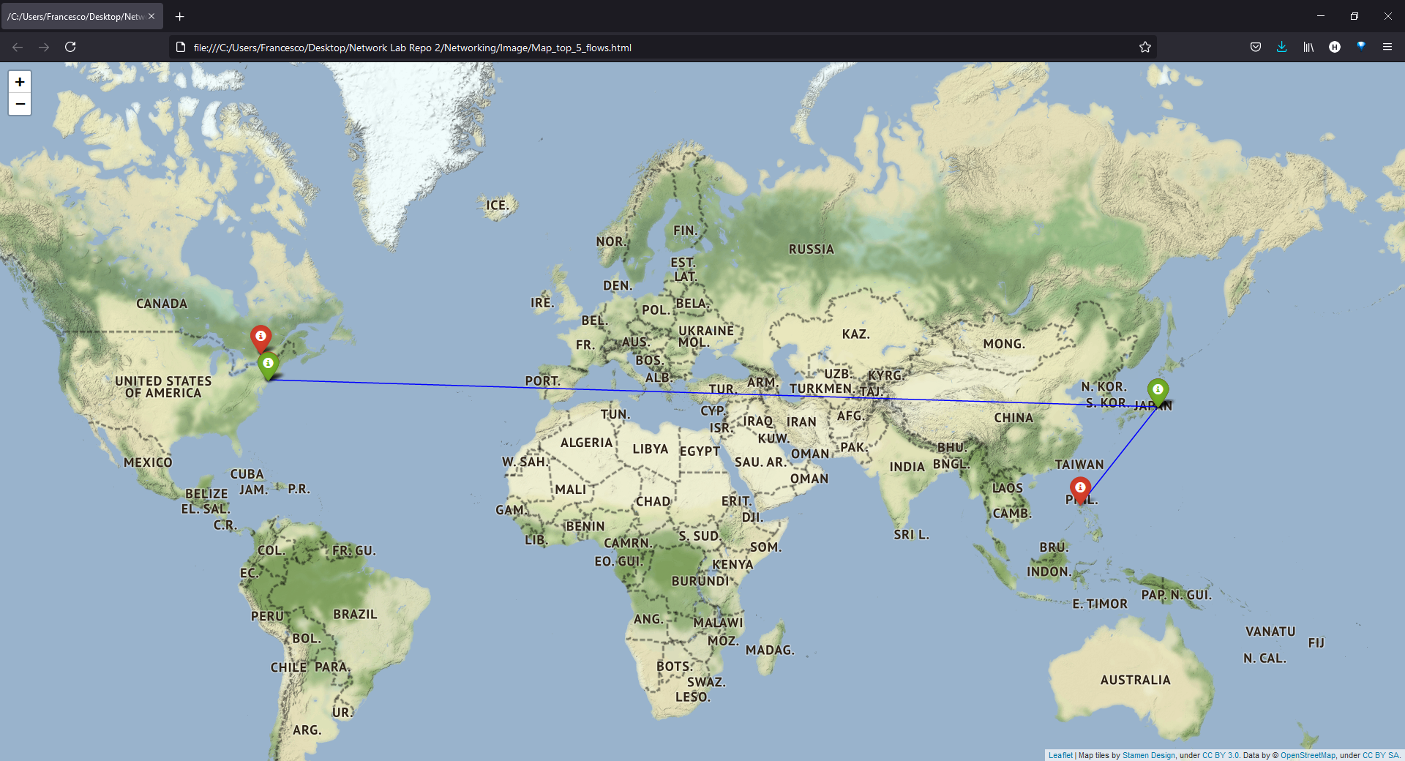
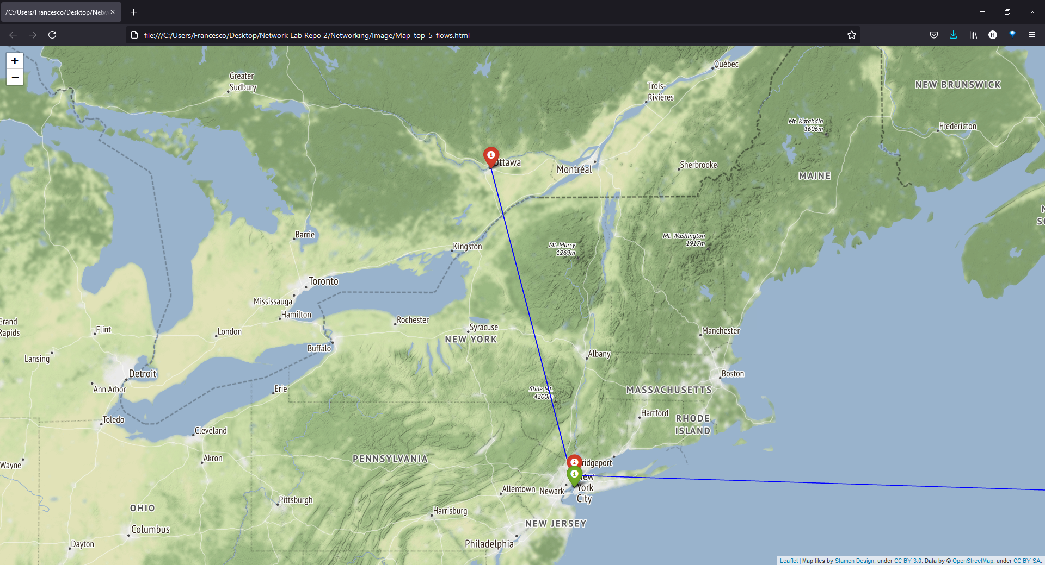
GeoLocal Referenciation
Source information
Latitude | Longitude | Region
40.712728 | -74.006015 | New York
40.712728 | -74.006015 | New York
35.693810 | 139.753216 | Tokyo
35.693810 | 139.753216 | Tokyo
35.693810 | 139.753216 | Tokyo
Destination information
Latitude | Longitude | Region
45.422527 | -75.683390 | Ontario
45.422527 | -75.683390 | Ontario
14.528887 | 121.069917 | National Capital
35.693810 | 139.753216 | Tokyo
40.886016 | -74.007257 | New Jersey

Slide 9
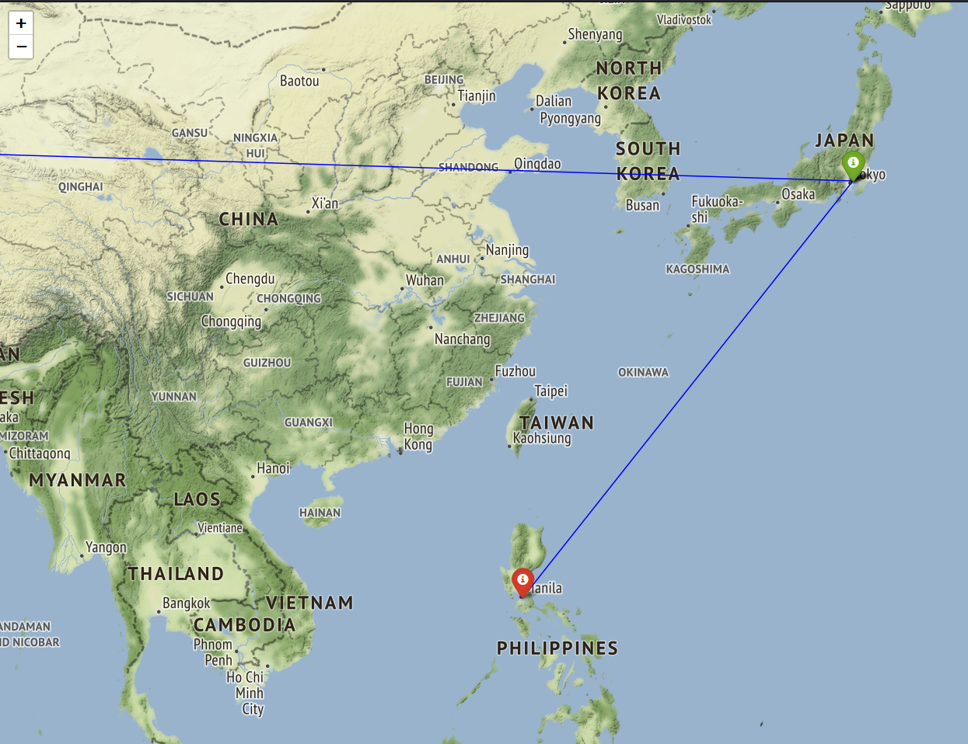
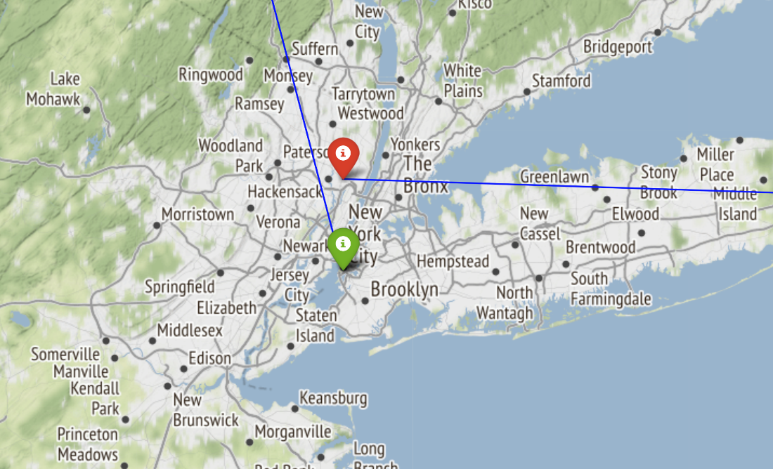
GeoLocal Referenciation
5 sessions with the highest amount of packet sent
IP_source | IP_destination | Packet sent
172.201.24.110 | 131.137.54.7 | 53309
172.201.24.79 | 131.137.37.197 | 30821
150.57.136.251 | 222.127.201.52 | 25606
150.57.136.251 | 221.5.73.197 | 20599
150.57.136.251 | 66.132.46.70 | 16946
Part of the code:
df_srcdst = list(zip(data_couple.IP_SRC, data_couple.IP_DST))
Counter(df_srcdst).most_common(5)

Slide 10
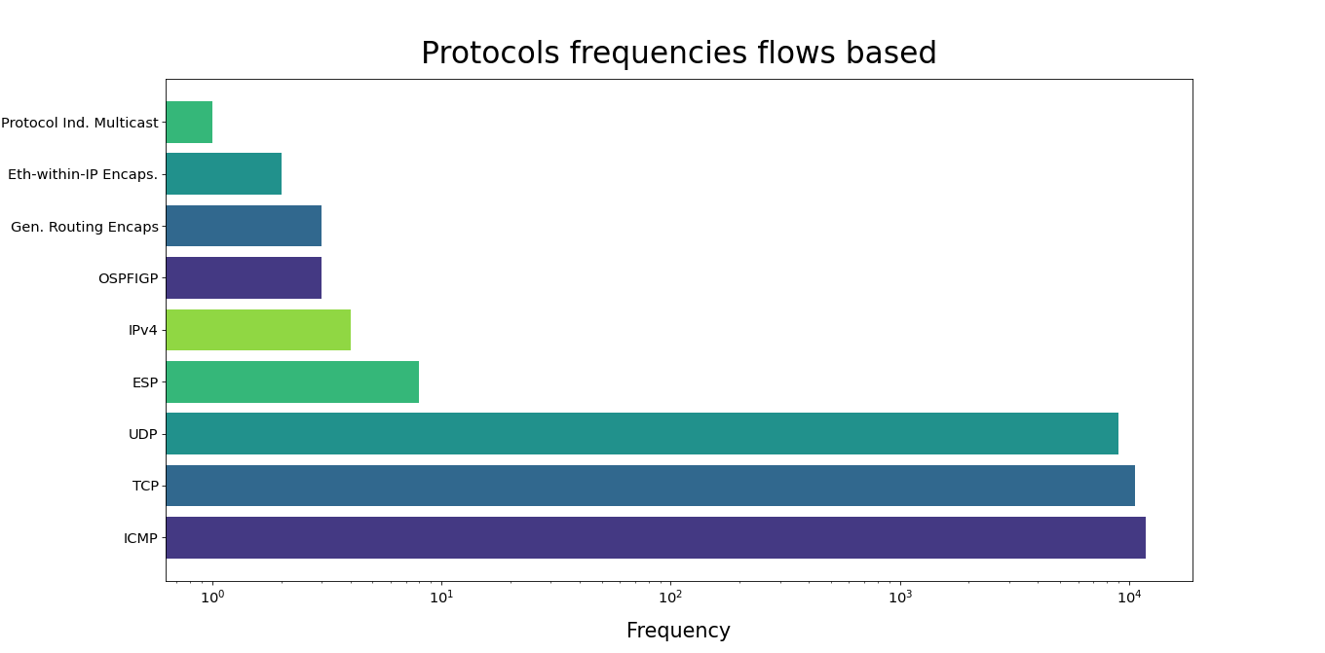

Slide 11
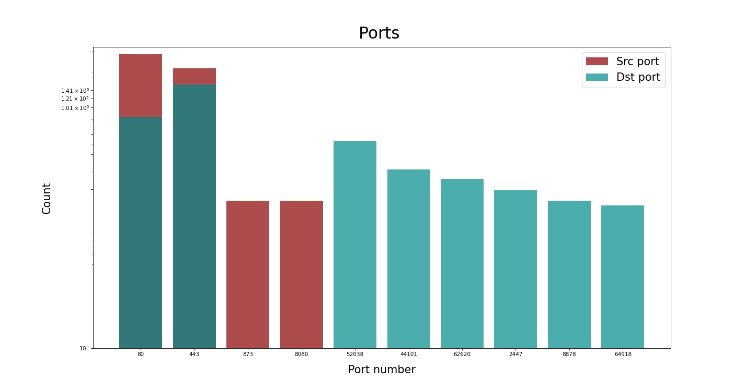
Port Scanner evaluation : 10 Ports mostly used
10⁴

Slide 12
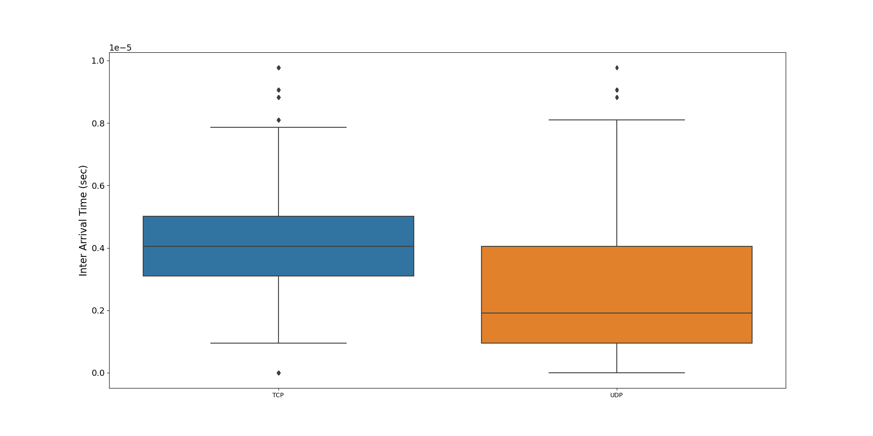
InterArrival Time boxplot between TCP and UDP Sessions

Slide 13
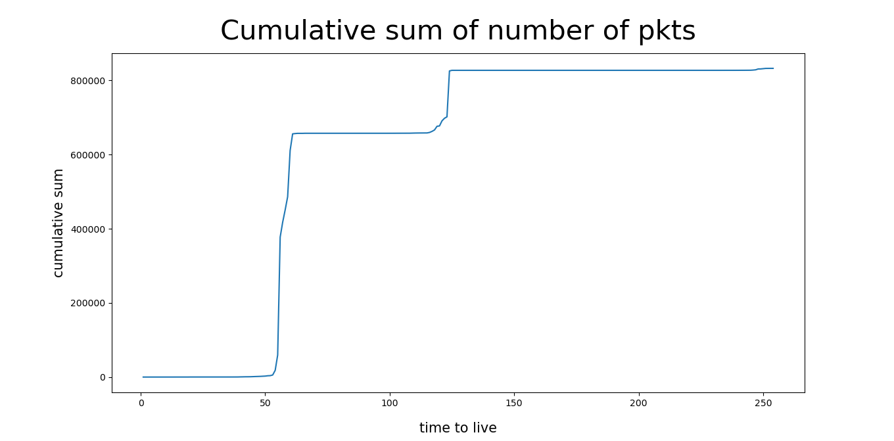
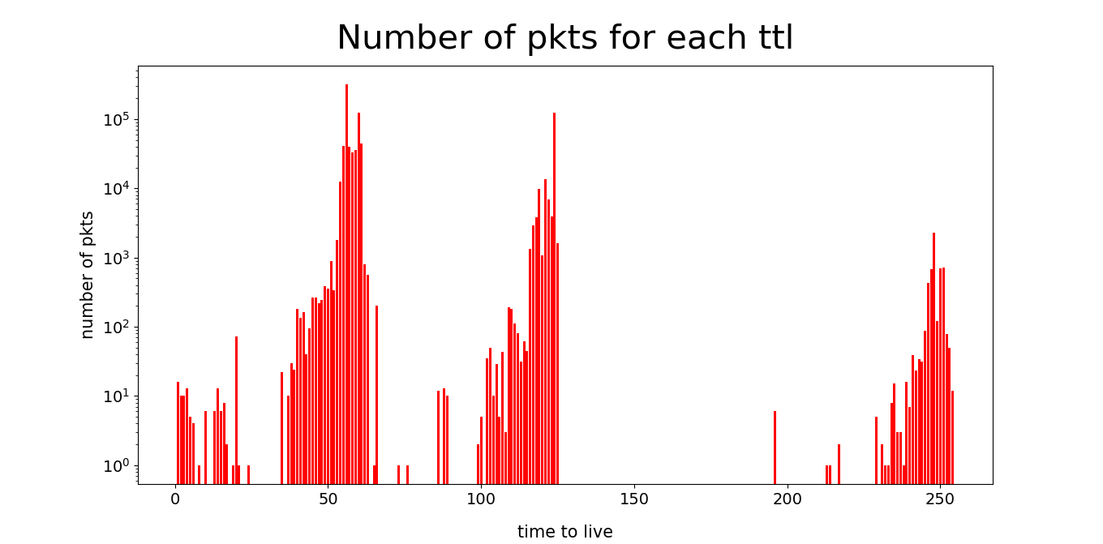
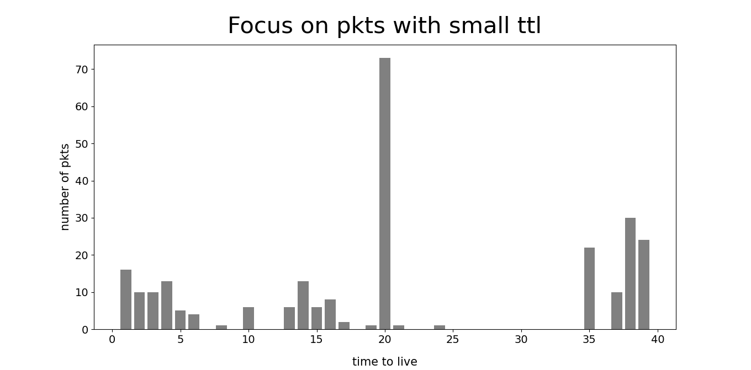
Evaluation about TTL

Slide 14
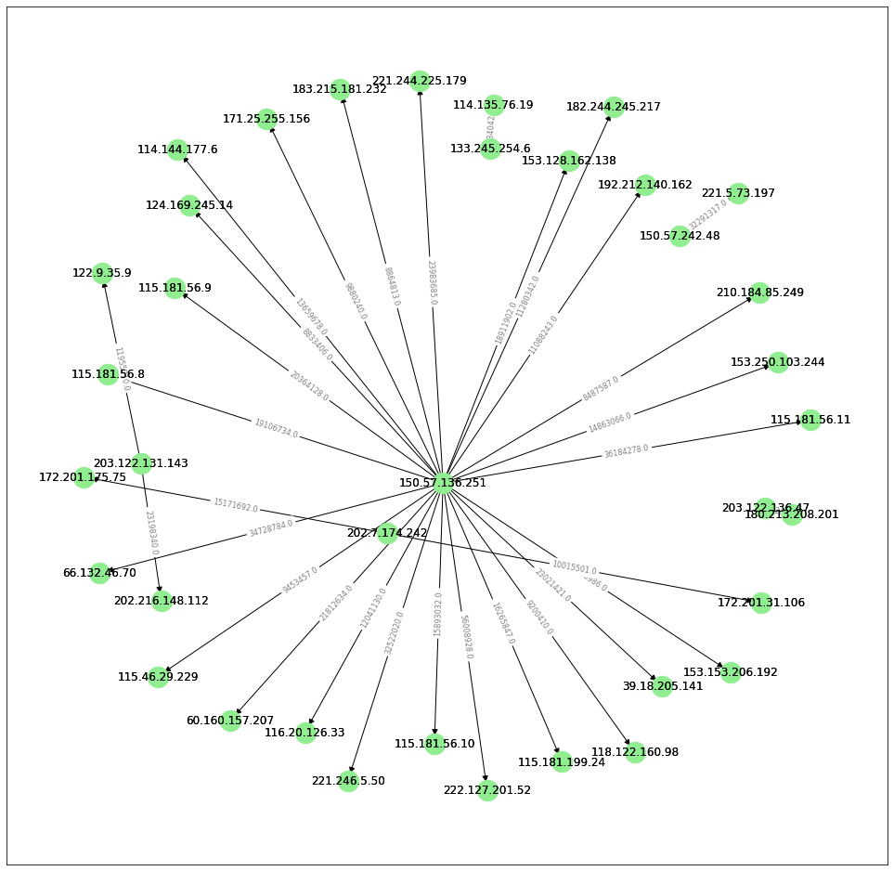
Topology of the network using networkx
Part of the Code:
d = df.groupby(["IP_SRC","IP_DST"])[["length"]].agg('sum’).
sort_values(by=["length"],ascending= False)
d[:31].unstack().fillna(0)
pos = nx.spring_layout(G)

Slide 15
Supervised Learning-Classification Problem
We select an endpoint (IP and port destination) and then observe all the traffics that this endpoint receives during a time interval. So we create a set of couple of IP_dest and port_dest
The feature are the number of packets and bytes received by an endpoint: create two normalized vectors based on log₂ that for each source part evaluate n. of pkts and bytes sent.
So at the end each record represent an endpoint and forty columns (first twenty for the n. of pkts vector and the last twenty for the n. of bytes vector) and column x for example represents how many flows in the source part sent 2^{x} pkts or bytes
LABEL - DSCP:information about the priority of the packet
1) Best Effort (lowest priority)
2) Scavenger (Not known in dataset)
3) Assured Forwarding (AF)
4) Expedited Forwarding (EF) (traffic used by bank. For payments)
5) Network & Internetwork control (NIC) (messages related to the performance of the network)

Slide 16
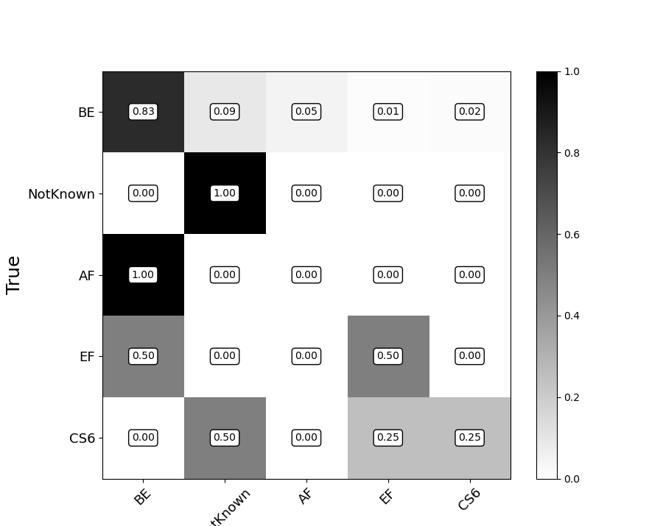
SVC
Since the support for all the classes except the Best Effort was very limited, we have performed SMOTE oversampling so to have a correct classification. The accuracy of SVC is 0.82 that is much higher than other classification algorithm that we have tried like Random Forest and Naive Bayes: their score is circa 0.68
{0,1,2,3,4} ["AF","BE","CS6","EF","NotKnown"]
With oversampling:
Train: Counter({0: 5627, 1: 5627, 2: 5627, 3: 5627, 4: 5627})
Test: Counter({0: 2, 1: 1879, 2: 7, 3: 3, 4: 1})
Without oversampling: Train: Counter({1: 5627, 2: 28, 4: 9, 0: 6, 3: 4})
Test: Counter({0: 2, 1: 1879, 2: 7, 3: 3, 4: 1})

Slide 17
SVC-Classification Report
Our Prediction based on the DSCP label: Counter({'EF': 29, 'NotKnown': 183, 'AF': 87, 'BE': 1552, 'CS6': 41})
 | Precision | Recall | F1-score | Support
AF | 0.00 | 0.00 | 0.00 | 2
BE | 1.00 | 0.82 | 0.90 | 1879
CS6 | 0.05 | 0.29 | 0.08 | 7
EF | 0.03 | 0.33 | 0.06 | 3
NotKnown | 0.01 | 1.00 | 0.01 | 1
Accuracy | 0.82 |  |  | 1892
Through a GridSearchCV using a 3-cross validation the best parameters set found on development set is:
kernel: ‘rbf’, gamma: 0.01, C: 1000
With the GridSearchCV we have not obtained very different results.

Slide 18
THANK YOU!

